Slide 1
Systemic Therapy for BRAF and MET
Gregory J. Riely

Slide 2
Disclosures
MSKCC receives or has received research funding for my work from:
Mirati
Lilly
Takeda
Merck
Roche
Pfizer
Novartis
Amgen

Slide 3
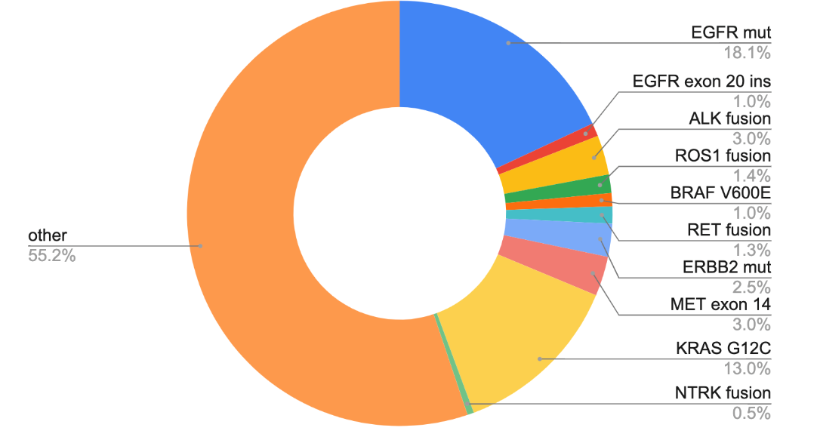
Lung cancer molecular subtypes with FDA-approved agents
AACR GENIE BPC lung, Data available at https://genie.cbioportal.org/
Notes:
NCCN Clin Info MH 3/28/23: this repeats slides 10, 18, 51

Slide 4
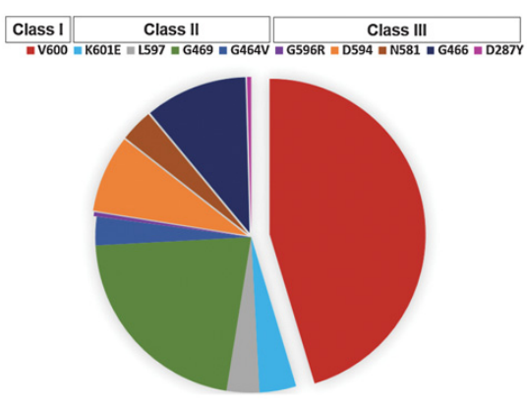
There are many types of BRAF mutations
 | Category | examples
Class 1 | Ras independent, signal as active monomers | V600
Class 2 | Ras independent, constitutively active dimers | K601, L597, G469, G464, fusions
Class 3 | Ras dependent, impaired/dead kinase activity | D287, V459, G466, S467, D594
Yao et al, Nature 2017, Dagogo-Jack et al, CCR 2019

Slide 5
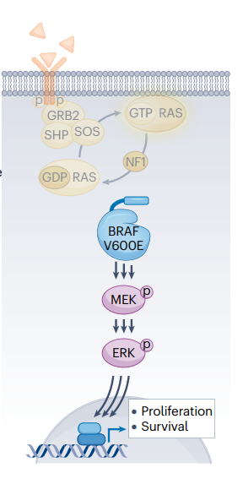
Targeting BRAF is best done with combined inhibition of BRAF and MEK
Inhibiting BRAF
Inhibiting MEK
Hanrahan et al, Nat Rev Clin Onc 2024

Slide 6
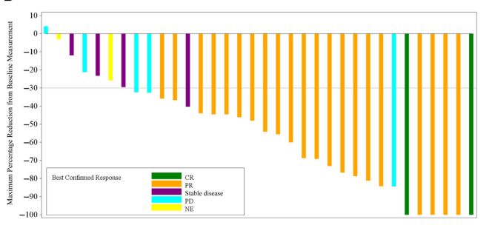
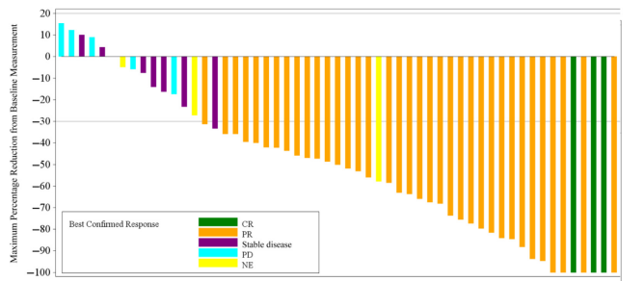
Dabrafenib (BRAF inhibitor) + Trametinib (MEK inhibitor) have efficacy in patients with metastatic BRAF V600E NSCLC
Treatment naïve
Previously treated
Response Rate 68%
Response Rate 64%
Planchard et al, JTO 2021

Slide 7
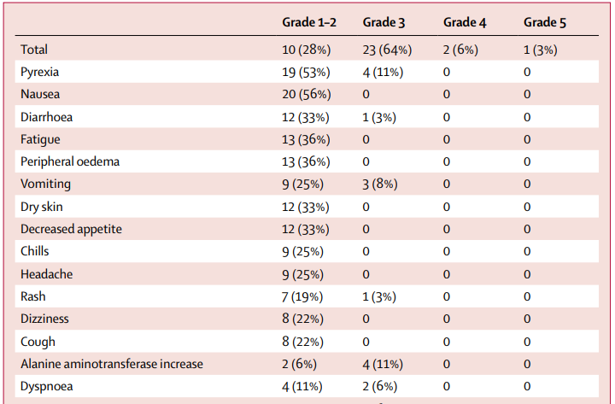
Dabrafenib (BRAF inhibitor) + Trametinib (MEK inhibitor) toxicities include pyrexia, nausea, diarrhea
Modified from Planchard et al, Lancet Onc 2017

Slide 8
Encorafenib + Binimetinib in BRAF V600E-mutant metastatic NSCLC: A single-arm, open-label, multicenter, phase 2 study
Key eligibility criteria
BRAF V600E–mutant metastatic NSCLC
ECOG performance status 0 or 1
No EGFR mutation, ALK fusion, or ROS1 rearrangement
No more than 1 prior line of treatment in the advanced setting
No prior treatment with BRAF or MEK inhibitor
No symptomatic brain metastases
Encorafenib: 450 mg QD
Binimetinib: 45 mg BID
28-day cycles
Treat until progression or unacceptable toxicity
Treatment naïve n=59
Patients enrolled
Previously treated n=39
Primary endpoint
ORR by lRR
Secondary endpoints
ORR by investigator
DOR, DCR, PFS, and TTR (all by lRR and investigator)
OS
Safety
Exploratory endpoints
Biomarker and pharmacokinetic analyses
NCT03915951
Riely et al, ASCO 2023 Abstract 9018

Slide 9
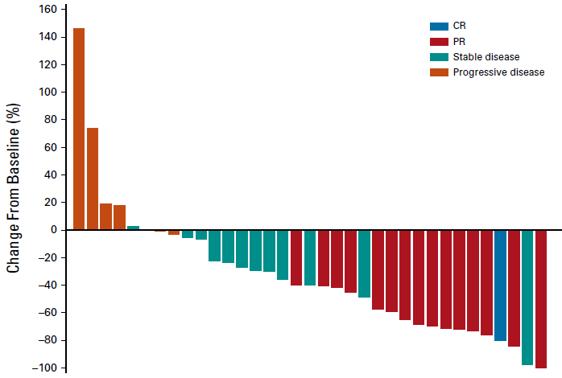
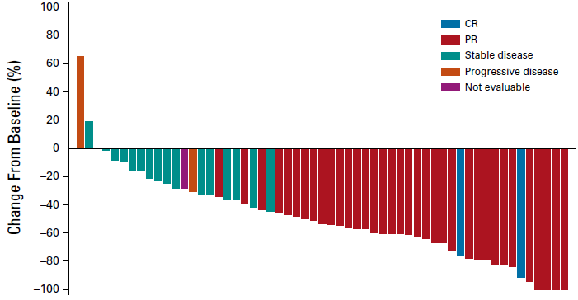
Encorafenib plus binimetinib has efficacy in patients with BRAF V600E-mutant metastatic NSCLC
Treatment naïve (n=57)
Previously treated (n=35)
Response rate 75% (95% CI: 62-85)
Response rate 46% (95% CI: 30-63)
Median Duration of Response 40 months
Median Duration of Response17 months
Riely et al, J Clin Onc 2023, ESMO 2024

Slide 10
Encorafenib + Binimetinib Updated Progression-free survival
Treatment naive (n=59)
Previously treated (n=39)
100
No. of PFS events, n (%) | 28 (47)
Median duration of follow-up for PFS (95% CI), months | 33.3 (30.4, 41.3)
Median PFS (95% CI), months | 30.2 (15.7, NE)
100
No. of PFS events, n (%) | 20 (51)
Median duration of follow-up for PFS (95% CI), months | 14.0 (11.3, 44.2)
Median PFS (95% CI), months | 9.3 (6.2, 24.8)
90
90
80
80
70
68%
70
60
56%
60
Progression-free survival, %
Progression-free survival, %
48%
50
43%
50
40
40
33%
30
30
27%
20
20
10
10
0
0
0
59
4
45
8
36
12
30
16
28
20
23
24
22
28
20
32
16
36
10
40
10
44
7
48
4
52
3
56
0
0
39
4
24
8
16
12
12
16
7
20
6
24
5
28
4
32
4
36
4
40
4
44
3
48
0
52
0
56
0
No. at risk
Treatment naive
Months
No. at risk
Previously treated
Months
Riely et al, JTO 2025

Slide 11
Encorafenib + Binimetinib toxicities include nausea, diarrhea, but pyrexia is much less common
most common TRAEs (≥15%) by treatment line
Treatment naive (n=59)
Previously treated (n=39)
Nausea
59%
41%
Diarrhea
41%
49%
All treatment-related events of pyrexia were grade 1 or 2
Fatigue
31%
33%
Vomiting
31%
28%
 | Grade 1 | Grade 2
Treatment naive | 10% | 2%
Previously treated | 3% | 0%
Vision blurred
20%
15%
ALT increased
19%
5%
AST increased
19%
5%
Anemia
17%
18%
Grade 1
Constipation
15%
13%
Grade 2
Pruritus
10%
15%
Grade 3/4
Asthenia
5%
18%
60
40
20
0
20
40
60
Patients, %
Riely et al, JTO 2025

Slide 12
For patients with metastatic BRAF V600E:
Standard initial therapy is with combination of BRAF and MEK
BRAF inhibitor
Dabrafenib
Encorafenib
+
OR
+
MEK inhibitor
Trametinib
Binimetinib
Note: no randomized data comparing with chemotherapy or chemotherapy/immunotherapy

Slide 13
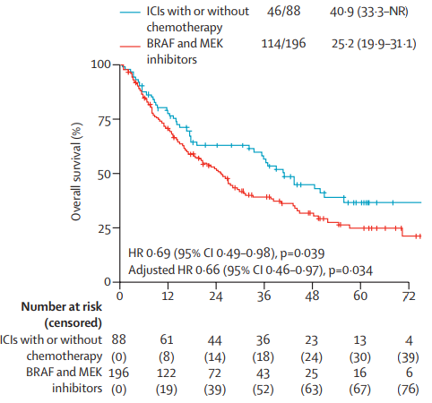
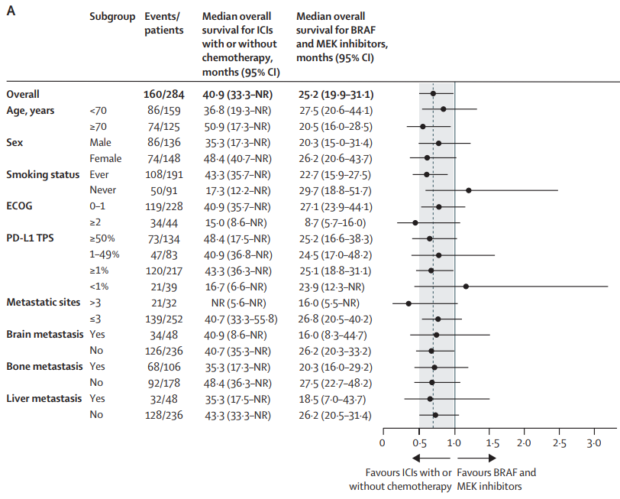
Front-line treatment with ICI+/-chemotherapy may be as/more effective than targeted therapy, (less true in never smokers, PD-L1 negative)

Slide 14
MET exon 14 mutations occur in a small proportion of patients with NSCLC
Lung cancer molecular subtypes with FDA-approved agents
AACR GENIE BPC lung, Data available at https://genie.cbioportal.org/
Notes:
NCCN Clin Info MH 3/28/23: this repeats slides 10, 18, 51

Slide 15
MET Exon 14 Alterations in NSCLC
Happen in 4-5% of patients with NSCLC
More likely in elderly patients
Some association with sarcomatoid histology

Slide 16
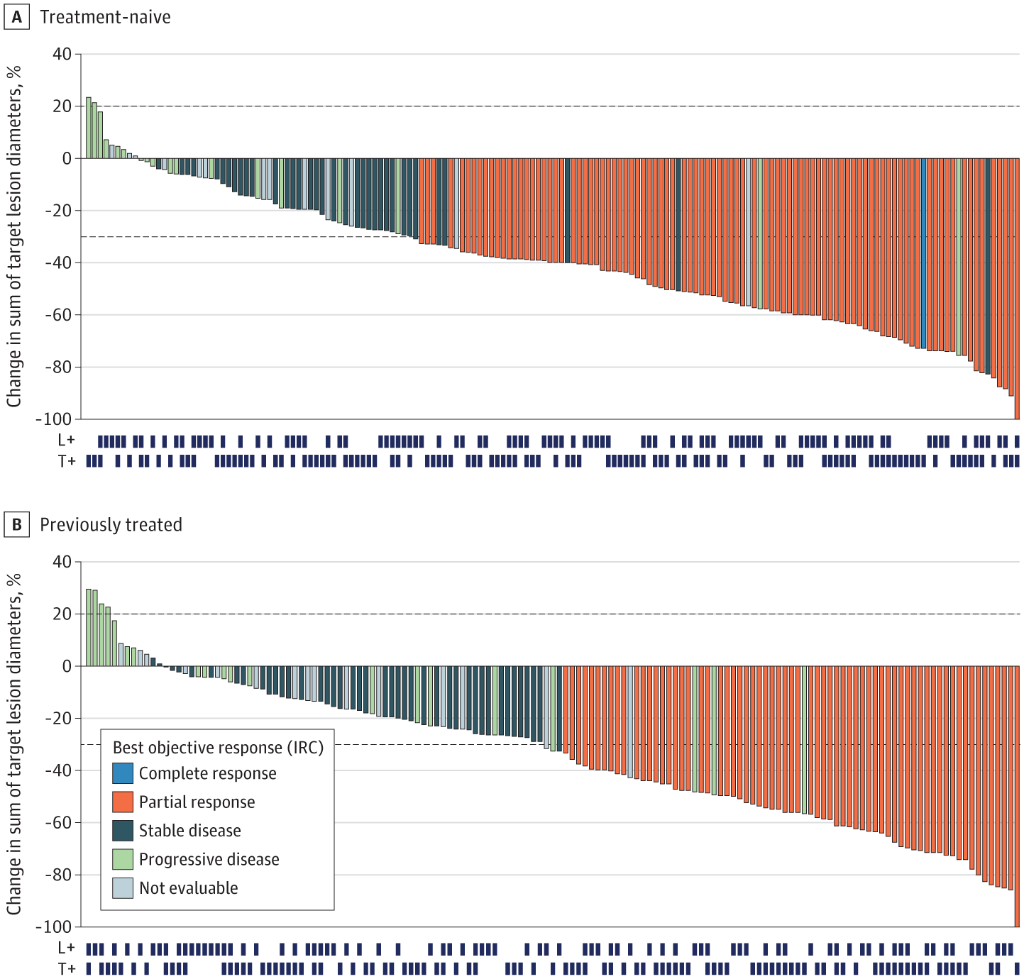
Tepotinib has efficacy in patients with and without prior therapy and with MET exon 14 identified on tumor or plasma analysis
Response Rate – 45%
Median PFS – 11 mo
Median DOR – 12.6 mo
Response Rate – 57%
Median PFS – 12.6 mo
Median DOR – 46.4 mo
Mazieres et al, JAMA ONC 2023

Slide 17
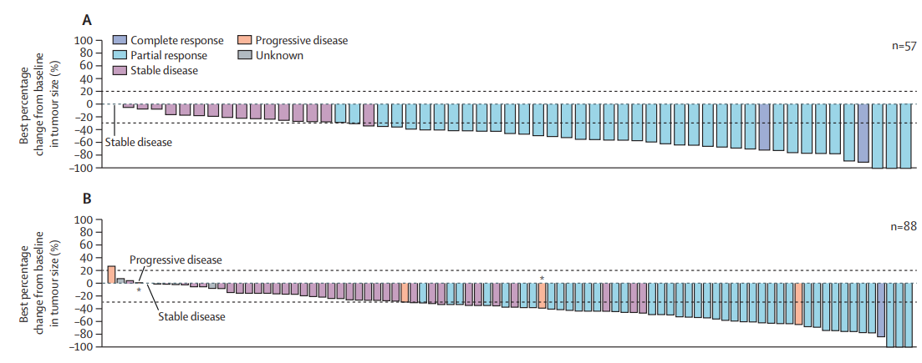
Capmatinib has efficacy in patients with and without prior therapy and with MET exon 14
Treatment-Naïve
RR – 68%
mDOR – 17 mo
mPFS – 12.5 mo
Previously treated
RR – 44%
mDOR – 10 mo
mPFS – 6 mo
Wolf et al, Lancet Oncology 2024

Slide 18
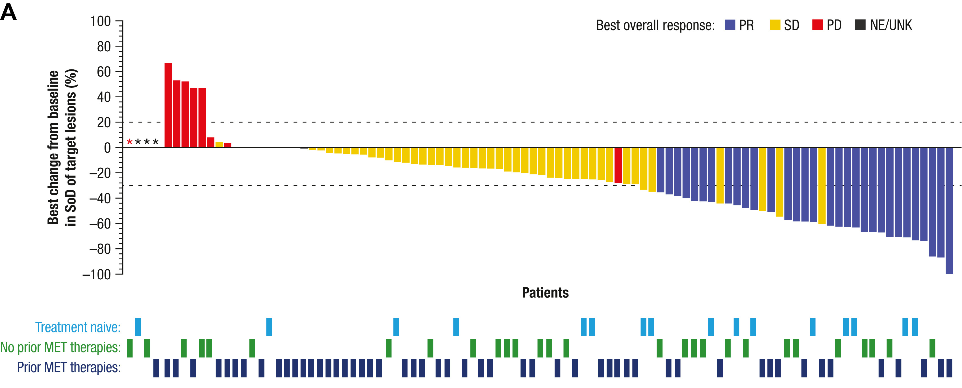
Amivantamab also has some efficacy in patients with MET exon 14
Treatment Naïve
Overall RR – 50%
mDOR – 3.2 mo
mPFS – 5 mo
Note:
RR after prior MET – 19%
EGFR
MET
Krebs et al, JTO 2025

Slide 19
For patients with metastatic MET exon 14 alterations:
Standard initial therapy is with a MET inhibitor
Capmatinib
OR
Tepotinib
Note: no randomized data comparing these targeted therapies to each other or with chemotherapy or chemotherapy/immunotherapy

Slide 20
But, there is another way MET can be targeted
c-Met high
(≥50% of tumor cells with 3+ intensity)
or
c-Met intermediate
(25% to <50% of tumor cells with 3+ intensity)
Telisotuzumab vedotin
MET
vedotin

Slide 21
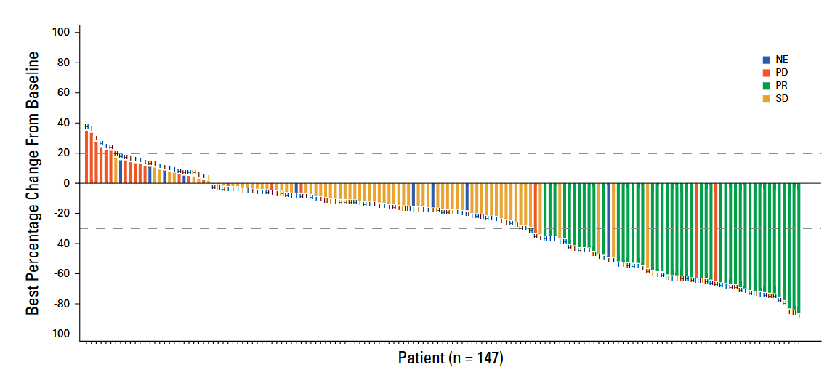
Telisotuzumab vedotin has efficacy in patients with MET overexpression
In patients with high MET expression (>50% with 3+)
RR – 35%
mDOR 9 months
mPFS 15 months
FDA-approved for patients with ≥ 50% of tumor cells with strong (3+) staining

Slide 22
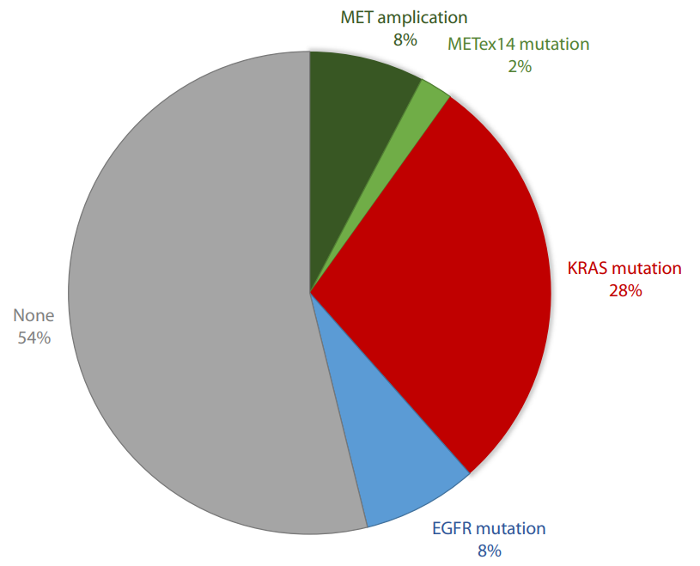
MET overexpression is not associated with MET exon 14
Alterations in patients with high-level MET overexpression

Slide 23
Key Take Home Points
Tumor testing can identify numerous targetable oncogenic drivers as well as overexpression of MET (and HER2)
If BRAF V600E mutations are identified, it is standard to begin with combination of BRAF and MET inhibitor
For MET exon 14, the standard initial therapy is MET inhibitor such as capmatinib or tepotinib
For MET overexpression (overlaps with a number of oncogenic drivers), use of telisotuzumab vedotin can be considered

